Slide 1
HW 1

Slide 2
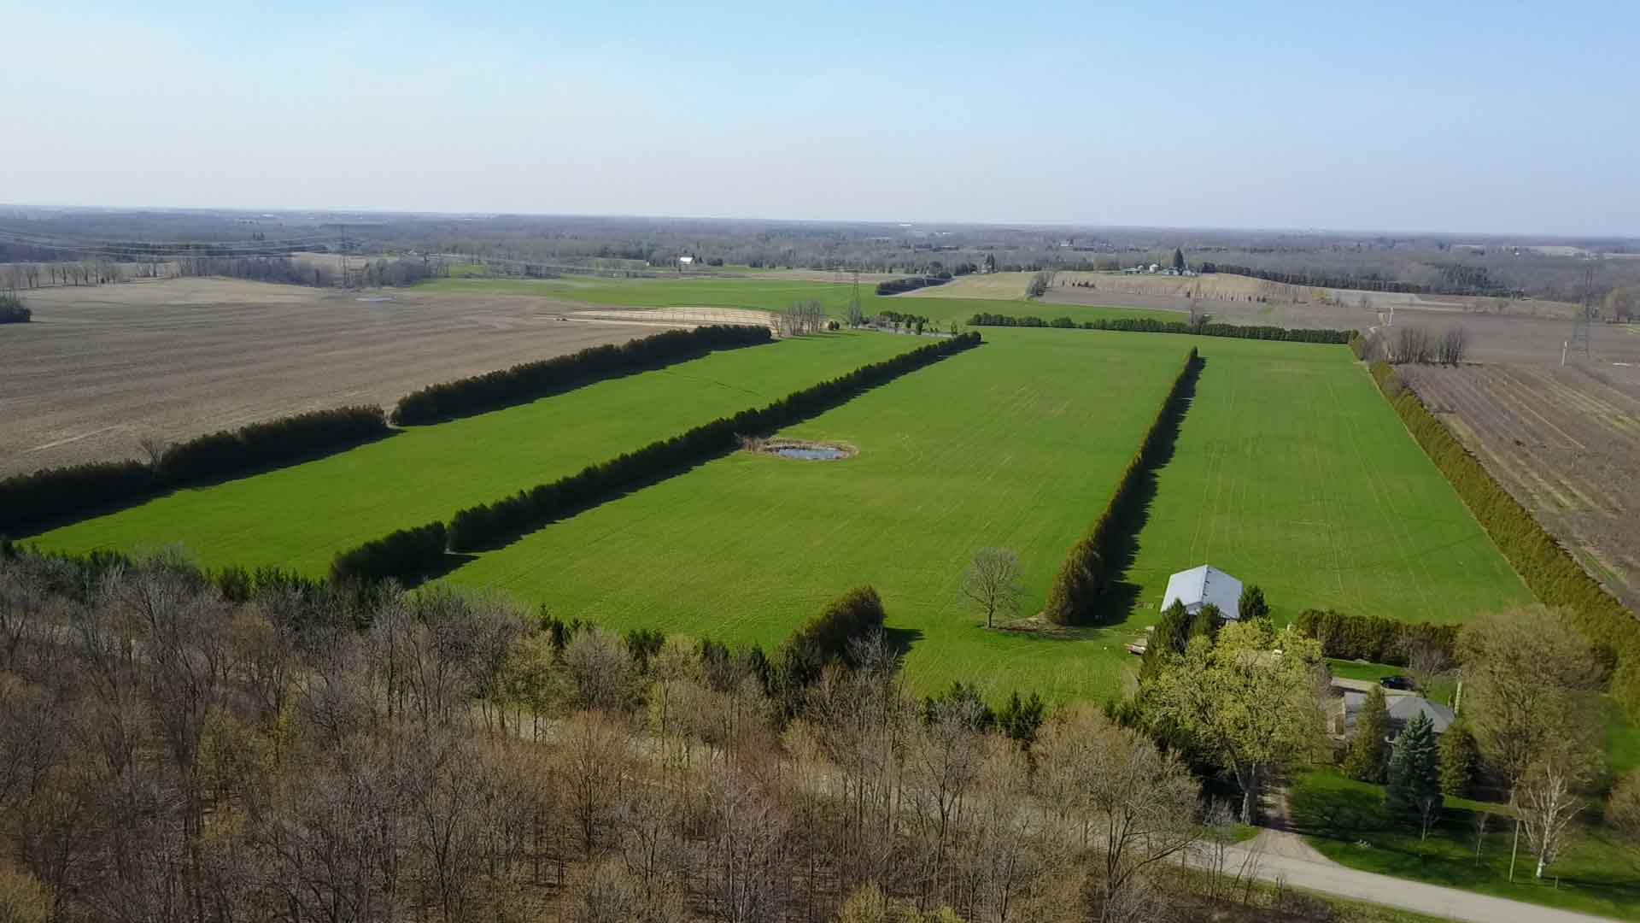
Problem:
- Forests can catch fire easily. - Putting out fires frequently increases amount of available wood acting as fuel. - Immediately putting out forest fire is not the best strategy. - Is there an alternative strategy.?
Motivation: - Historically, humans have partitioned large areas of land into rectangles for farming. - Forest is a large piece of land. - PARTITION INTO GRID!!!
- Each rectangular cell becomes more manageable.
https://adamdegroote.com/wp-content/uploads/2017/04/DJI_0023.MOV.Still002.jpg

Slide 3
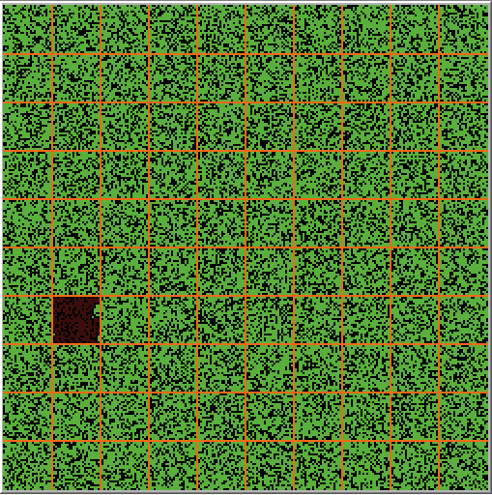
Preliminaries:
- Orange: roads to travel around forest. - each green cell: area of a forest.
Our Approach Is:
- simpler: for chopping forest, you only need to cut straight lines. (which is easy, pythagoras!!) - risk free: if one cell burns, it's fine (since cells are disconnected with roads in between) - environmental friendly: can travel from one area to forest to another with "at most" one turn. - scalable: each rectangular grid cell can be partitioned into more rectangular cells (recursive nature) - pocket friendly: no need to capture satellite images of whole forest periodically. only look at a particular grid cell (locality)

Slide 4
Procedure:
- Input: initial density of the trees in the forest, grid cell size. - create a rectangular grid of grid_size.
Metrics:
[1] Percent of trees chopped.
[2] Percent of trees lost in case of accidental burn in a grid cell.
[3] Total percent of trees lost = % trees chopped + % trees lost in case of accidental burn in a grid cell.
Experiments:
- Exp1: For a fixed initial density of the trees, variation as grid_size increases.
- Exp2: For a fixed grid cell size, how does tree density impact the above metrics.
Numerical Stability & Reproducibility:
- All experiments were ran 100 times. mean and standard deviation are reported.

Slide 5
Exp 1: variation as grid_size increases, constant density.
Exp 2: variation as density increases, constant
Density | % of trees chopped | % burned | Total % lost
10 | 7.24 | 0 | 7.24
20 | 6.92 | 0.03 | 6.95
30 | 7.1 | 0.03 | 7.13
40 | 7.08 | 0.03 | 7.11
50 | 6.98 | 0.04 | 7.02
60 | 6.92 | 0.04 | 6.97
70 | 6.99 | 0.78 | 7.78
80 | 6.99 | 0.93 | 7.91
90 | 7.01 | 0.93 | 7.94
99 | 7.05 | 0.91 | 7.96
Grid Size | % of trees chopped | % burned | Total % lost
5 | 3.23 | 3.77 | 7
10 | 7.05 | 0.03 | 7.08
15 | 10.73 | 0.34 | 11.07
20 | 14.52 | 0.17 | 14.69
25 | 18.23 | 0.12 | 18.36
30 | 21.91 | 0.03 | 21.95
35 | 25.22 | 0.01 | 25.23
At 65 percent density
Grid size 10

Slide 6
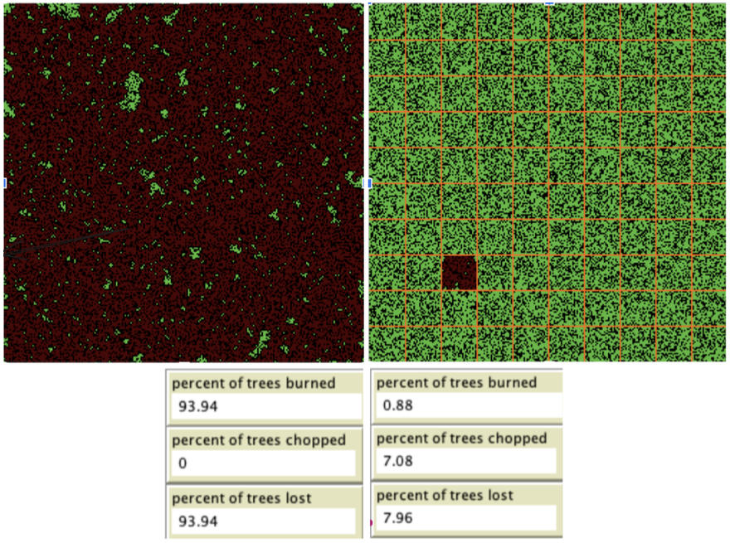
Original
Optimized
Density = 65%

Slide 7
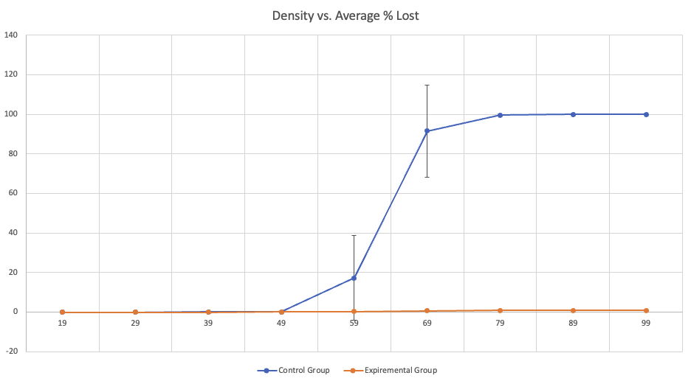
Using 100 runs
Percent
Density

Slide 8
Conclusion
^{We:} - propose a novel algorithm for overcoming losses due to forest fires by gridding the forest into rectangular patches. - show that the proposed approach performs better than a naive baseline which might involve randomly trimming certain regions of the forest. - analyze the impact of the initial tree density and grid cell size on the total number of trees which will be lost in case of an accidental fire. - show that our approach is also environmentally sustainable by minimizing the number of trees lost, and also guaranteeing minimum damage in case of fire.

